Slide 1
Summary of Landfill Gas Data

Slide 2
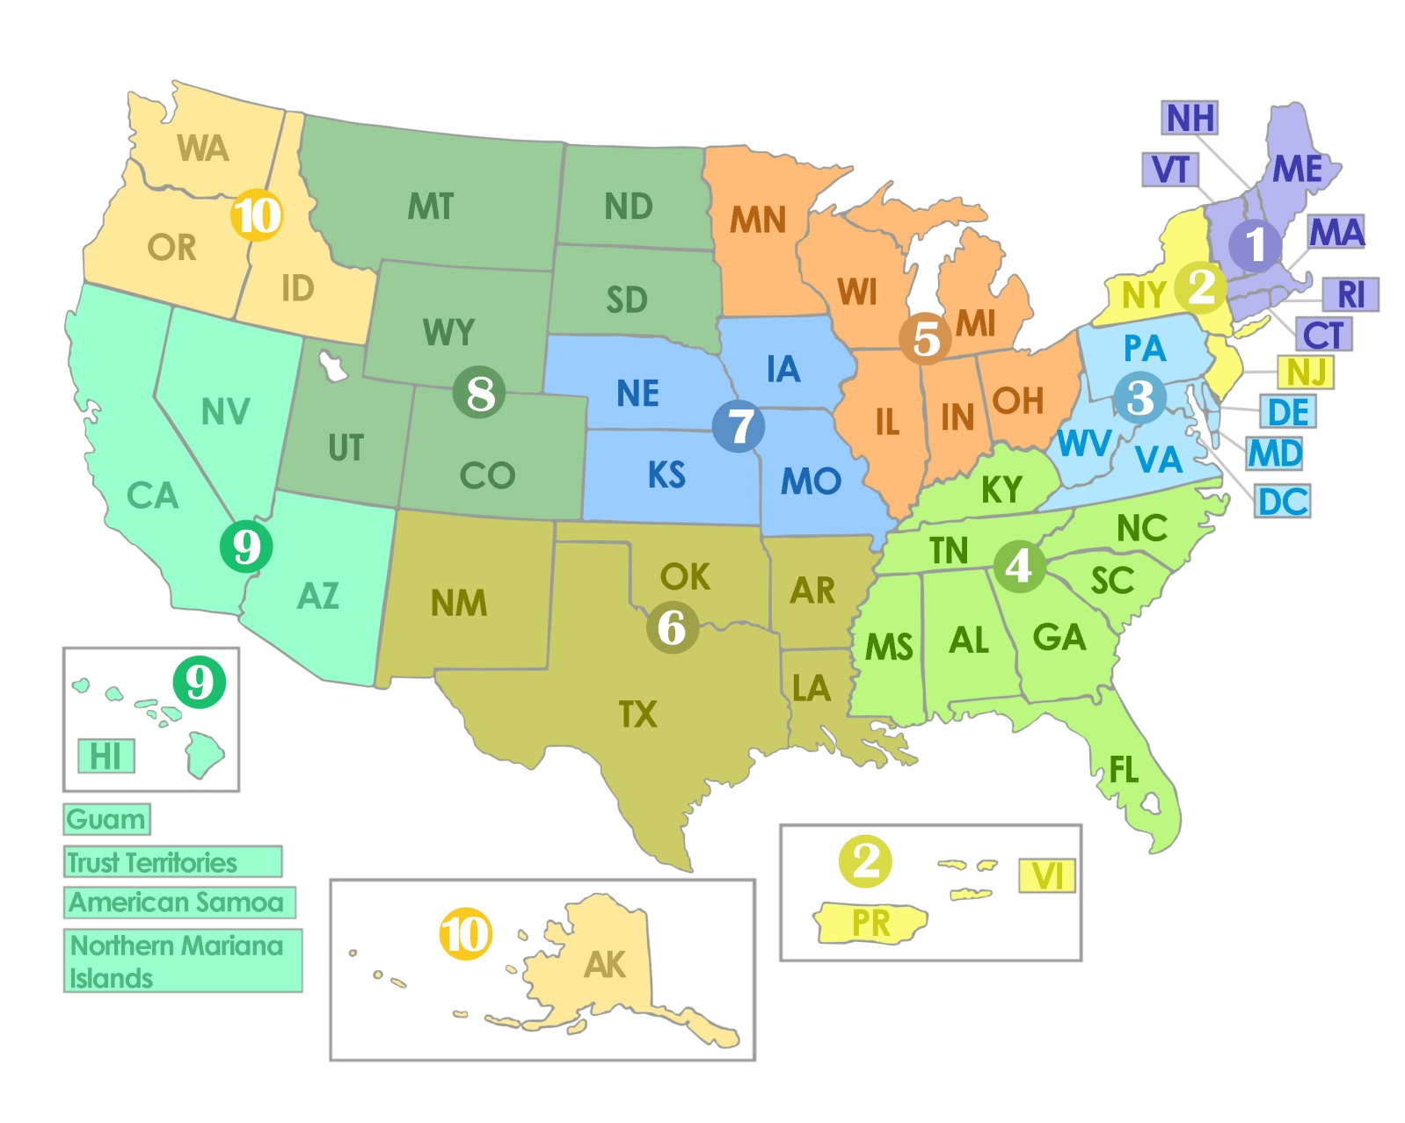
Proposed Regionalization
Notes:
Issues to Consider:
Data availability
Differences in landfills regionally
Model and data complexity
California called out as being particularly different

Slide 3
Data Review – Landfills
Landfills (LMOP Data)
Includes potential, candidate, and operational landfills reported by state
No historic data
Waste Generation
EPA dataset is national
Can use another data source (Columbia University MSW survey) to partition among states for 2011
Historic data or regional data for 2011 available. Not both.
Notes:
After removing landfills without data and operational landfills that are not producing electricity or CNG/LNG.

Slide 4
Data Review – Biogas
Biogas Yield from Waste
No regional or historic data (i.e. LMOP)
Use EIA landfill gas stratification assumption to connect EPA waste generation assumptions to gas production?
Methane Content in Biogas and Annual Biogas Production?
No regional or historic data
No current plans to improve
Conversion efficiency
Using placeholders. These don’t look right.
20% for electricity and 80% for CNG.
Notes:
After removing landfills without data and operational landfills that are not producing electricity or CNG/LNG.

Slide 5
Data Review – Costs and Prices
Cost and Financial Assumptions
No historic or regional data
Expected Electricity and CNG prices
Electricity: No regional or historic numbers
Use expected price for natural gas electricity?
CNG: Some regional (not by state) and historic data from the AFDC

Slide 6
Data Review – Policy
RIN assumptions for biogas and electricity
No major improvements
Other policies?
Are there other policies we need to include? E.g., Renewable Electricity Production Tax Credit (PTC)?
Notes:
After removing landfills without data and operational landfills that are not producing electricity or CNG/LNG.

Slide 7
Potentially Useful Calibration Data
Landfill gas consumption and electricity generation from the EIA.
Nationally for the last 10 years
Or by state for the last 3 years
Net costs of electricity and pipeline biogas for landfills.
Based on LMOP so could be regionalized. No historic data available
Other datasets to look for:
Need historic use of electricity for transportation?
Natural gas prices?

Slide 8
Other Data
EIA data on how methane production from landfills is calculated
Per capita MSW generation by state in 2011

